Slide 1
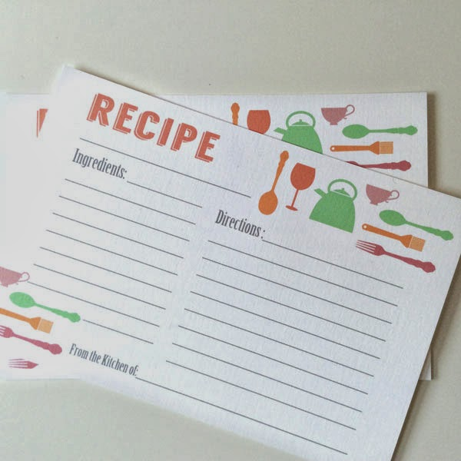
A Recipe for Grant Writing Success by Christine LaFond, Director Clear Lake Public Library clafond@clearlakelibrary.org 715-263-2802

Slide 2
I have used grant money to purchase or fund
- large print books - audiobooks
- dvds - art supplies
- archival supplies - performers
- speakers - microscopes
- computers, tablets, printers
- books that are on the suggested reading lists in the
Collaborative Summer Reading Program Manual
- a chair lift for the local Community Center

Slide 3
- LED lights
- tuck pointing of the local Museum
- a heating/cooling system for the local Museum
- a handicapped accessible boat dock for the
lake at our local park
- a portable sound system
- handicapped accessible computer desks
- a new library
- furniture for a new library

Slide 4
Assumptions
- You need to apply for a grant because you have
exhausted all of your local resources
- You have permission to implement your idea
- You are excited about your idea

Slide 5
EQUIPMENT & TOOLS

Slide 6
Equipment
- computer - scanner
- printer - file folder(s)
- flash drive - calendar
- digital and/or hard copy
- access to a fax machine

Slide 7
Tools
- access to the internet
- word processing program
- designated spot to keep all of your grant information and
applications
- time

Slide 8
- someone who will review your work
- typos are bad
- don’t depend upon a spellchecker program
- plain language
- webinar by Rebecca Kilde, IFLS PR and Communications
Coordinator, is found at https://vimeo.com/519624792/
- avoid library jargon
Ex: check out not circulation

Slide 9
- Library’s Annual Report
I. General Information
- DUNS Number (Data Universal Numbering System)
II. Library Collection
- Number Owned
Books (Print and Electronic)
Audio Materials
Video Materials
Other Materials (Ex: Kits)
Subscriptions (Periodicals and Newspapers)

Slide 10
III. Library Services
- Total Circulation
- Registered Users
- Library Visits
- Library Programs and Attendance
IV. Library Governance
V. Library Operating Revenue
VI. Library Operating Expenditures

Slide 11
VII. Library Capital Revenue, Expenditures,
Debt Retirement and Rent
VIII. Other Funds Held by the Library Board
(Ex: Donation fund)
IX. Trust Funds
X. Staff

Slide 12
XI. Loans of Materials to Non-residents
XII. Technology
XIII. Self-directed Activities, Staff Serving
Youth/Adults

Slide 13
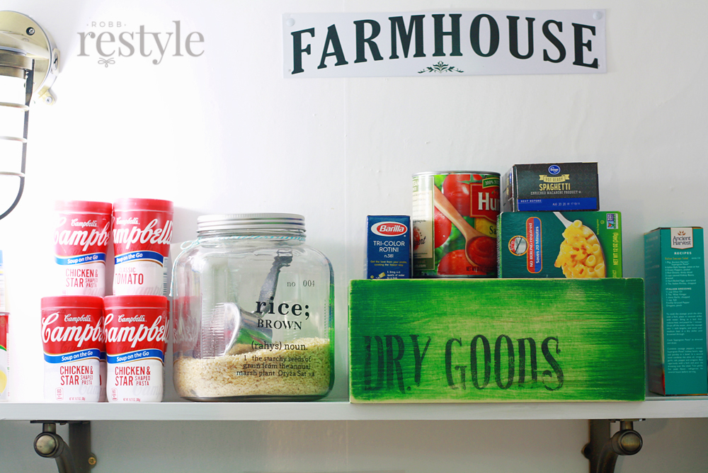
STOCK YOUR PANTRY

Slide 14
Basic Ingredients
- Library mission statement
- History of your library
- year founded
- founded by whom
- renovated building, to be more accessible for all
- moved to a new building
- added computers
- joined library consortium

Slide 15
- Major and minor accomplishments
- hosted a Smithsonian Institute traveling exhibition
- served 100 children in most recent Summer
Reading Program
- collaborated with elementary school on
After School Book to Movie Reading Club
- started/revived Friends of the Library Group

Slide 16
- Current activities
- Names of three references
- choose people who are supporters of your library
- review annually
- Possible partners
- school - Lions Club
- museum - community center
- senior center - senior housing
- daycare - another library
- sportsmen group - park board
- police department - fire department
- medical clinic - Community Education
- community theater

Slide 17
- Draft of a letter of support
- you can give to reference or partner quickly
- Library Budget
- Information about your community
- Service Population
https://dpi.wi.gov/pld/boards-directors/library-standards/
- Appendix C has several ways to calculate
service population
- Tax exempt statement
- I sometimes have to state Village of Clear Lake
dba Clear Lake Public Library

Slide 18
- Employer Identification Number (EIN)
- aka Federal Tax Identification Number
- 501 © 3 letter from IRS
- From your Friends of the Library
- I partner with the Clear Lake Historical Museum so I
have a copy of their letter
- Names of Library Board members and their
local affiliations
- If you have their permission, pictures of people
participating in library activities.

Slide 19
WHAT DO I WANT TO MAKE?

Slide 20
Do you want to work on a program? or a project?
- Program
- Ex: offer a summer reading program for the youth
of Clear Lake
- Project
- Ex: purchase 100 large print books
Can you partner with another local organization?
- contact a potential partner to discuss your idea
Look through your grant information to find the
grant that best matches your idea
-

Slide 21
THE RECIPE

Slide 22
Start with an easy grant if this is your first time
filling out an application
- your local electric company/cooperative
- area community foundation
Read through the whole application
- Can you start and stop the application or do you
need to complete it in one sitting?
- know when the grant is due and by what method
- submit early

Slide 23
Collect all of your items you will need for filling out the
application
“Go shopping” for items NOT in your pantry
- cover letter
- program budget
- project budget
- other sources of income
- list of measurable goals
Ex: The number of participants in the 2022
Summer Reading Program will increase by 10%
over the number of participants in the 2021
Summer Reading Program

Slide 24
- list of outcomes
Ex: The Library staff will increase their knowledge
regarding current technology trends and
will be able to share their knowledge by
offering computers classes
- thoughts on ways you will keep the
program/project going after the grant funds have
run out (sustainability)
If you can, learn the mission statement of the granting
organization and determine how it ties into your
library’s mission statement.

Slide 25
If you know someone who previously received the
grant for which you are thinking of applying,
contact that person.
Visit the granting organization’s website
- check for past recipients and their applications
- view webinar about their grant application process

Slide 26
QUALITY INGREDIENTS

Slide 27
Quality Ingredients
- Fonts
- Times New Roman or Arial
- Font size
- headings can be size 16
- subheadings can be size 13
- text should be size 12 unless otherwise
requested in the directions
- Spacing
- primarily single
- leave some white space, don’t want
application to be too busy

Slide 28
- Color
- primarily black
- limit use of color
- if using color, use the colors of your library logo
- Lists
- bulleted … for a list of equipment
- numbered … for order of steps
- Graphics
- use colors that are in your library logo
- Acronyms
- spell out the first time
- put the abbreviation in parenthesis… after the first
spelling
- use abbreviation throughout the rest of the application

Slide 29
RESOURCES

Slide 30
https://www.bridgeslibrarysystem.org/library.staff-resources/
https://iflsweb.org/
FOR IFLS LIBRARIES
RESOURCES
Budget, Data & Statistics
Grants
https://www.monarchlibraries.org/grant.funding-sources/
Nicolet Federated Library System
https://www.nfls.lib.wi.us/

Slide 31
Wisconsin Valley Library Service
https://wvls.org/grant-resources/
Eau Claire Public Library
https://www.ecpubliclibrary.info/foundations-grants/
- Offsite: use Foundation Directory Online Essential
- In the library
- use Foundation Directory Online Professional
- use Foundation Grants to Individuals
- use demo version of Foundations in Wisconsin

Slide 32
http://librarygrants.blogspot.com/
- for anyone interested in library grant opportunities
https://www.grants.gov/
- centralizes information from more than 1000
government grant programs
https://www.epa.gov/grants/ (Environmental Protection Agency)
- uses grants.gov portal
- citizen science
- periodically hosts webinars for the EPA grants community

Slide 33
https://imls.gov/grants (Institute of Museum and Library Services)
- uses grants.gov portal
- sample applications
- sign up to receive e-mail messages with news, updates
and stories about libraries and museums
https://www.demco.com/services/free-grant-search
https://www.scholastic.com/librarians/programs/grants.htm
https://wisconsin.grantwatch.com/
- sign up to receive free weekly newsletter
- Free: Grant synopsis and deadline
- Paid: View FULL grant details

Slide 34
https://fundsnetservices.com/wisconsin.grants-and foundations/
http://wifoundations.org/
- covers every active grant making foundation in WI
- annual subscription (IFLS currently pays for
In-Library use subscription)
- www.more.lib.wi.us/
Dig Deeper
Research Page
Foundations, Grants and Non-Profits
Foundations in Wisconsin
Member Login
Search

Slide 35
https://grantstation.com/
- membership fee
- periodic promotions offering lower prices
- serves non-profit organizations, educational
institutions, government agencies, and
religious organizations
https://www.city-data.com/
- population
- gender breakdown
- median age
- median household income
- percentage of residents living
- race
-

Slide 36
https://www.census.gov/
https://www.wisconsin-demographics.com/
https://candid.org/
- connects non-profits, foundations and individuals
to do good
https://www.webjunction.org/home.html
- “builds the knowledge, skills and confidence of library staff
to power strong libraries that are the heart of
vibrant communities”
https://learn.webjunction.org/

Slide 37
